Slide 1
COMP1860 Building our Digital World: Computer Systems & Architecture
S1.W2.L1: Number Systems & Integer Representations
Dr James Dyer

Slide 2
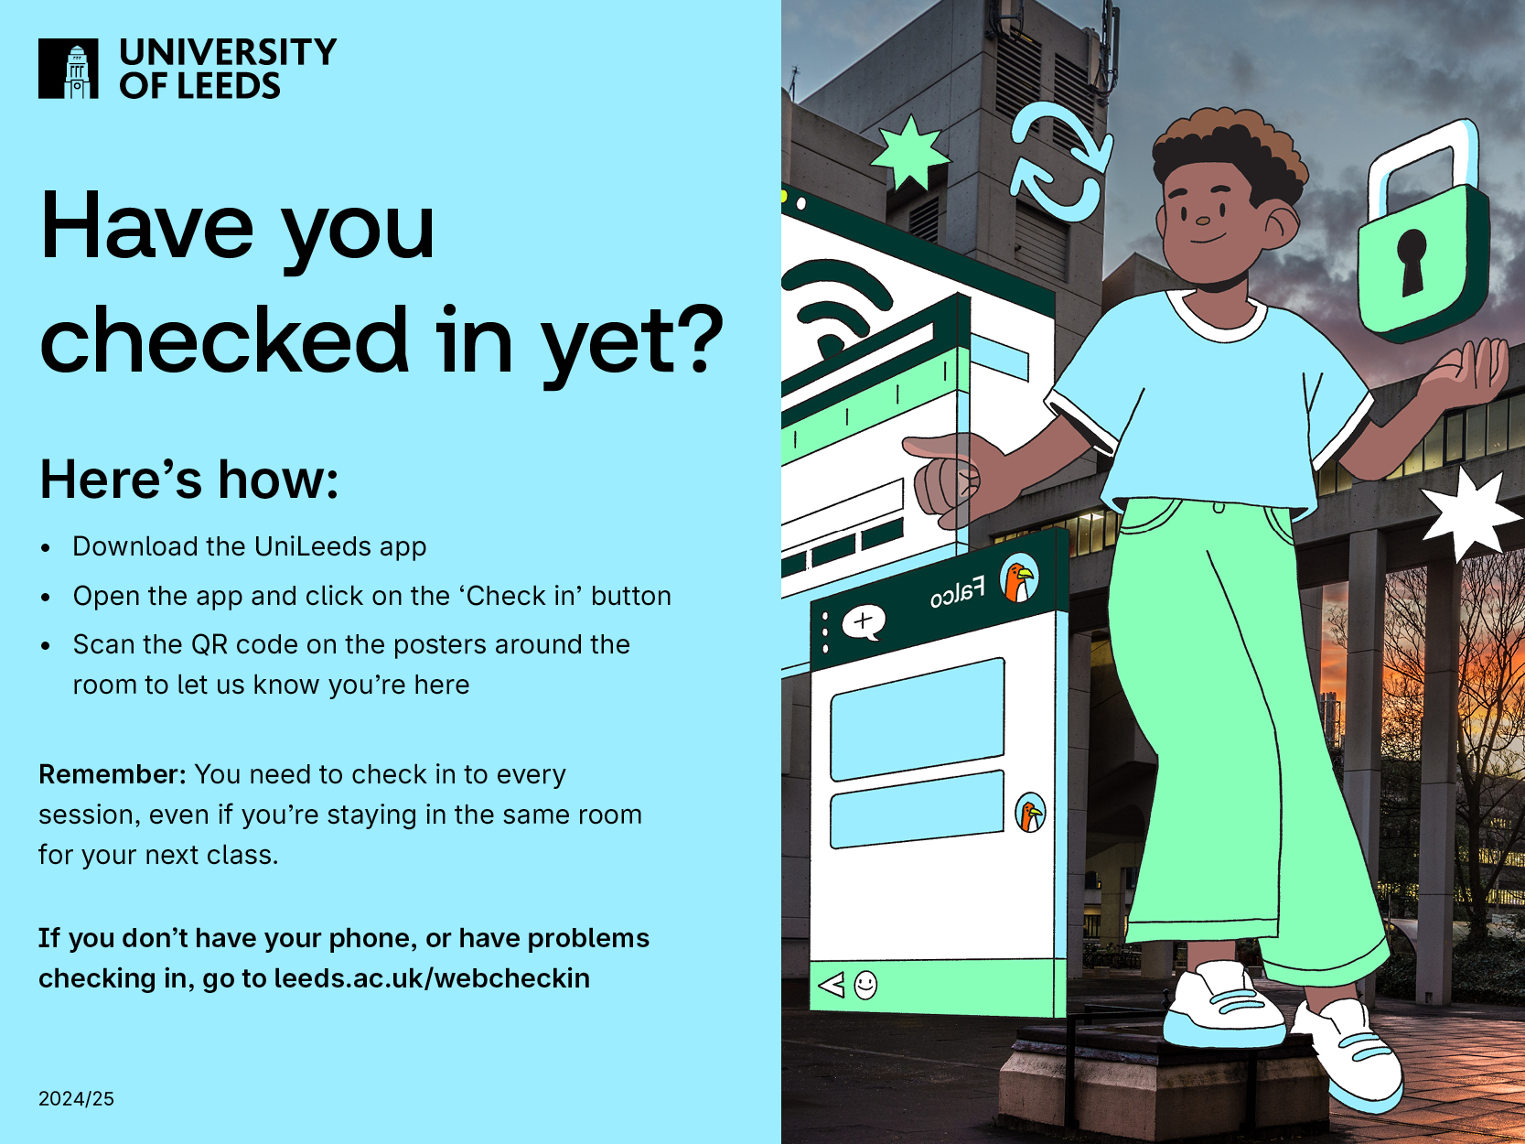

Slide 3
Learning Outcomes
Explain the bit-level representations of fixed-length numbers.
Translate numerical data from one format to another.

Slide 4
Text Book
This lecture covers material similar to chapters 10 & 11 of Stallings. Computer Organisation & Architecture
  It covers the entirety of chapter 10
  It covers section 11.2 of chapter 11 up to two’ complement representations

Slide 5
Overview
Number Systems
Integer Representations

Slide 6
Number Systems

Slide 7
Number Systems
Denary/Decimal or base ten - ten symbols
  0, 1, 2, 3, 4, 5, 6, 7, 8, 9
Binary or base two - two symbols
  0, 1
Hexadecimal or base 16 - sixteen symbols
  0, 1, 2, 3, 4, 5, 6, 7, 8, 9, A, B, C, D, E, F
Octal or base 8 - eight symbols
  0, 1, 2, 3, 4, 5, 6, 7.

Slide 8


Why Binary?
On
True
Yes
Off
False
No

Slide 9
Bits, Bytes and Words
Bit - binary digit
Byte - 8 bits
Word - 32 bits or 64 bits (in most systems).
The number of bits used to store numbers will determine the size of the numbers which can be stored and their precision.

Slide 10
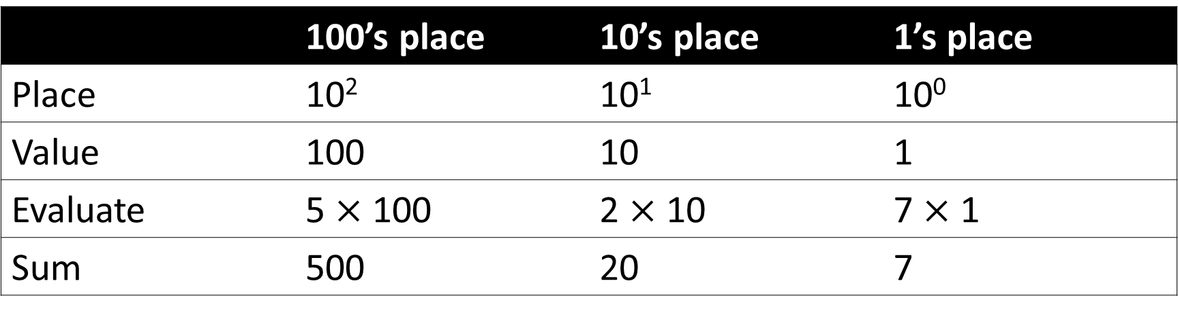
Positional notation: Base 10
527 = 5 $×$ 10² + 2 $×$ 10¹ + 7 $×$ 10⁰
 | 100’s place | 10’s place | 1’s place
Place | 10² | 10¹ | 10⁰
Value | 100 | 10 | 1
Evaluate | 5 $×$ 100 | 2 $×$ 10 | 7 $×$ 1
Sum | 500 | 20 | 7

Slide 11
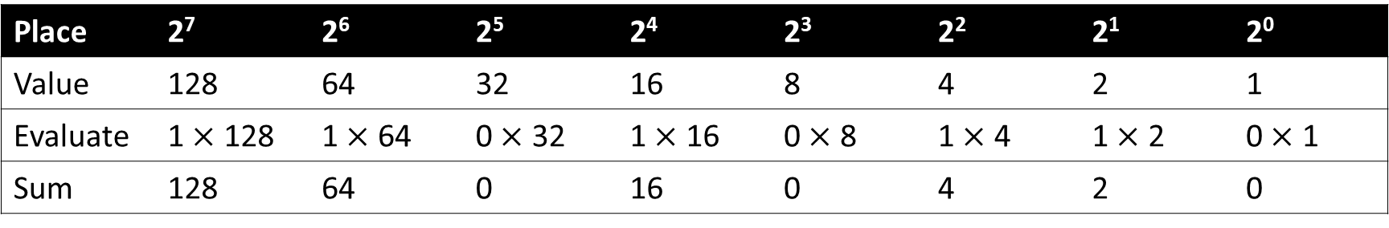
Positional notation: Base 2
1101 0110₂ = 214₁₀
Place | 2⁷ | 2⁶ | 2⁵ | 2⁴ | 2³ | 2² | 2¹ | 2⁰
Value | 128 | 64 | 32 | 16 | 8 | 4 | 2 | 1
Evaluate | 1 $×$ 128 | 1 $×$ 64 | 0 $×$ 32 | 1 $×$ 16 | 0 $×$ 8 | 1 $×$ 4 | 1 $×$ 2 | 0 $×$ 1
Sum | 128 | 64 | 0 | 16 | 0 | 4 | 2 | 0

Slide 12

Positional notation: Base B
$${d_{n}d_{n−1}…d}_{2}d_{1}d_{0}$$
$$≡d_{n}×B^{n}+d_{n−1}×B^{n−1}+…+d_{2}×B^{2}+d_{1}×B+d_{0}×1$$
$$≡\sum_{i=0}^{n}{d_{i}×B^{i}}$$

Slide 13
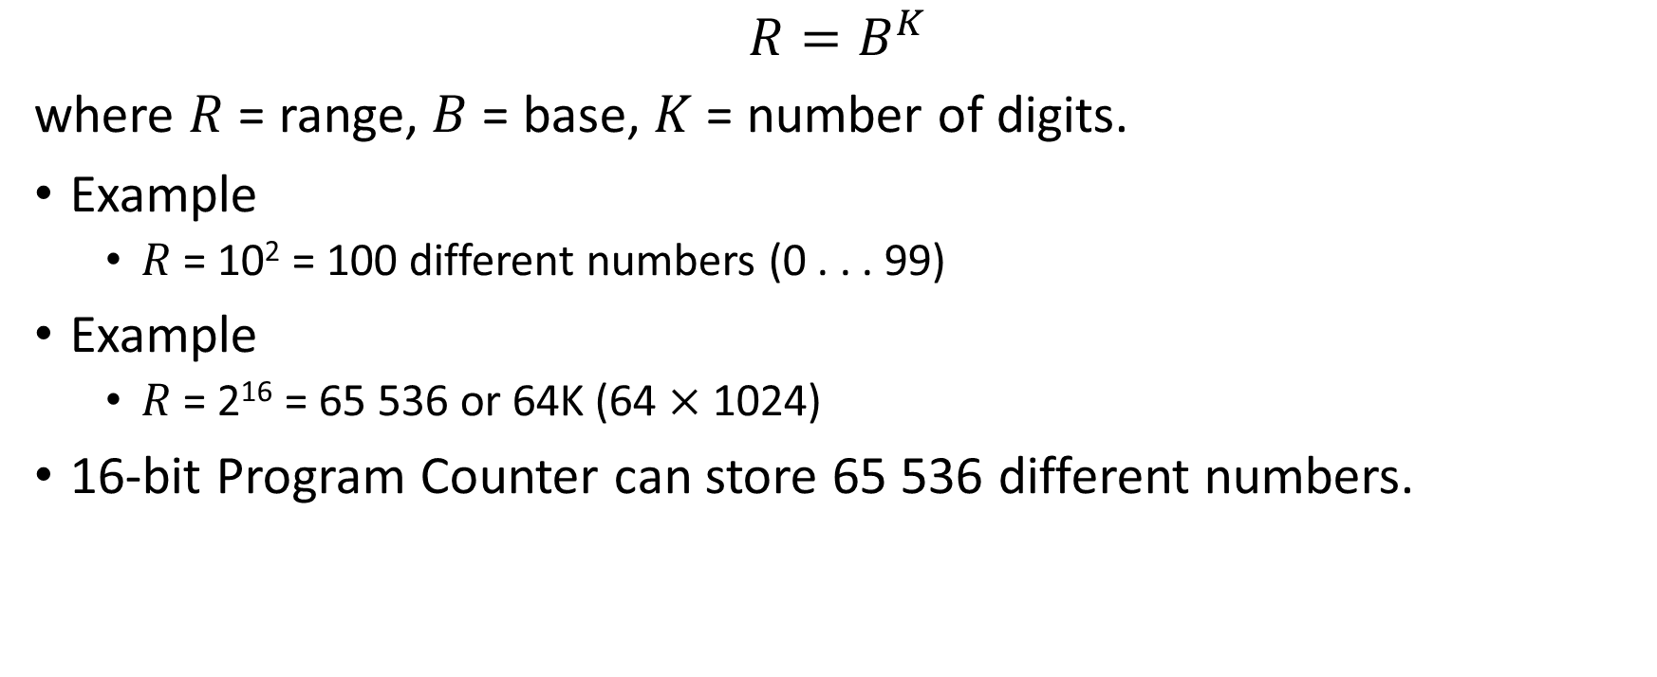
Range of possible numbers
$$R=B^{K}$$
where $R$ = range, $B$ = base, $K$ = number of digits.
Example
  $R$ = 10² = 100 different numbers (0 . . . 99)
Example
  $R$ = 2¹⁶ = 65 536 or 64K (64 $×$1024)
16-bit Program Counter can store 65 536 different numbers.

Slide 14
Bit widths
Bits | Width
1 | 2 (0 and 1)
4 | 16 (0 to 15)
8 | 256
10 | 1024 (1K)
16 | 65536 (64K)
20 | 1 048 576 (1M)
32 | 4 294 967 296 (4G)

Slide 15
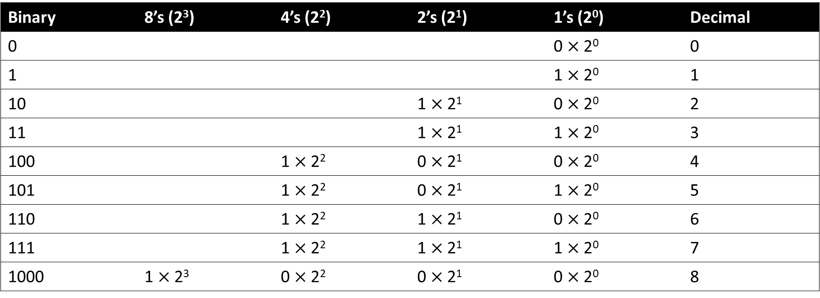
Counting in base 2
Binary | 8’s (2³) | 4’s (2²) | 2’s (2¹) | 1’s (2⁰) | Decimal
0 |  |  |  | 0 $×$ 2⁰ | 0
1 |  |  |  | 1 $×$ 2⁰ | 1
10 |  |  | 1 $×$ 2¹ | 0 $×$ 2⁰ | 2
11 |  |  | 1 $×$ 2¹ | 1 $×$ 2⁰ | 3
100 |  | 1 $×$ 2² | 0 $×$ 2¹ | 0 $×$ 2⁰ | 4
101 |  | 1 $×$ 2² | 0 $×$ 2¹ | 1 $×$ 2⁰ | 5
110 |  | 1 $×$ 2² | 1 $×$ 2¹ | 0 $×$ 2⁰ | 6
111 |  | 1 $×$ 2² | 1 $×$ 2¹ | 1 $×$ 2⁰ | 7
1000 | 1 $×$ 2³ | 0 $×$ 2² | 0 $×$ 2¹ | 0 $×$ 2⁰ | 8
Now You: Expand the table up to 15

Slide 16
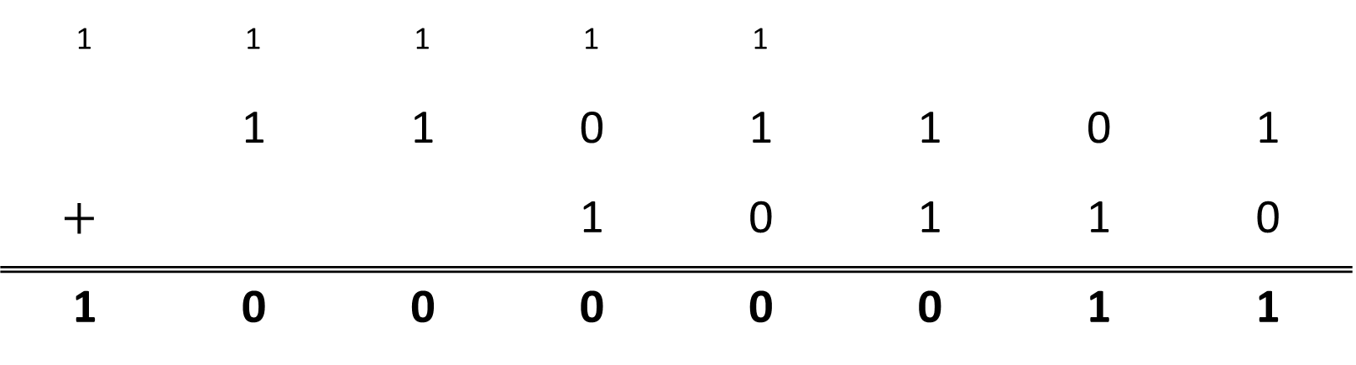
Binary Arithmetic
Example
  Compute (110 1101)₂ + (1 0110)₂.
₁ | ₁ | ₁ | ₁ | ₁
 | 1 | 1 | 0 | 1 | 1 | 0 | 1
$$+$$ |  |  | 1 | 0 | 1 | 1 | 0
1 | 0 | 0 | 0 | 0 | 0 | 1 | 1

Slide 17
Exercise: Binary Arithmetic
Now You:
Compute (1010)₂ + (1110)₂

Slide 18
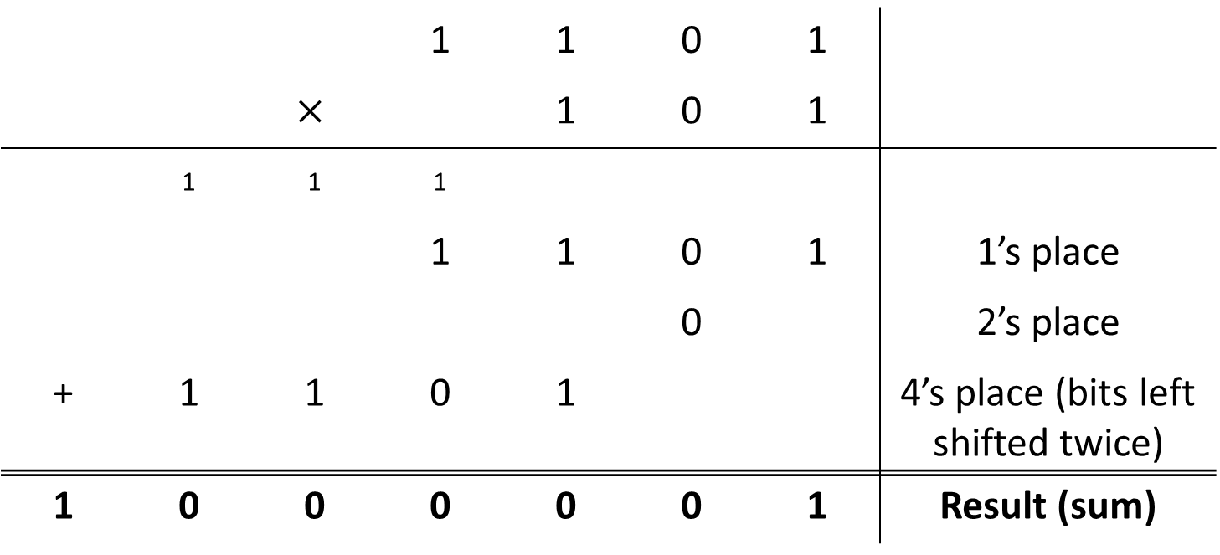
Binary Multiplication
Example
  Compute 1101₂ × 101₂.
 |  |  | 1 | 1 | 0 | 1
 |  | $$×$$ |  | 1 | 0 | 1
 | ₁ | ₁ | ₁
 |  |  | 1 | 1 | 0 | 1 | 1’s place
 |  |  |  |  | 0 |  | 2’s place
+ | 1 | 1 | 0 | 1 |  |  | 4’s place (bits left shifted twice)
1 | 0 | 0 | 0 | 0 | 0 | 1 | Result (sum)

Slide 19
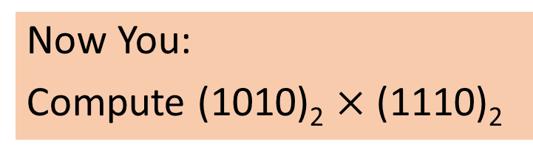
Exercise: Binary Multiplication
Now You:
Compute (1010)₂ $×$ (1110)₂

Slide 20
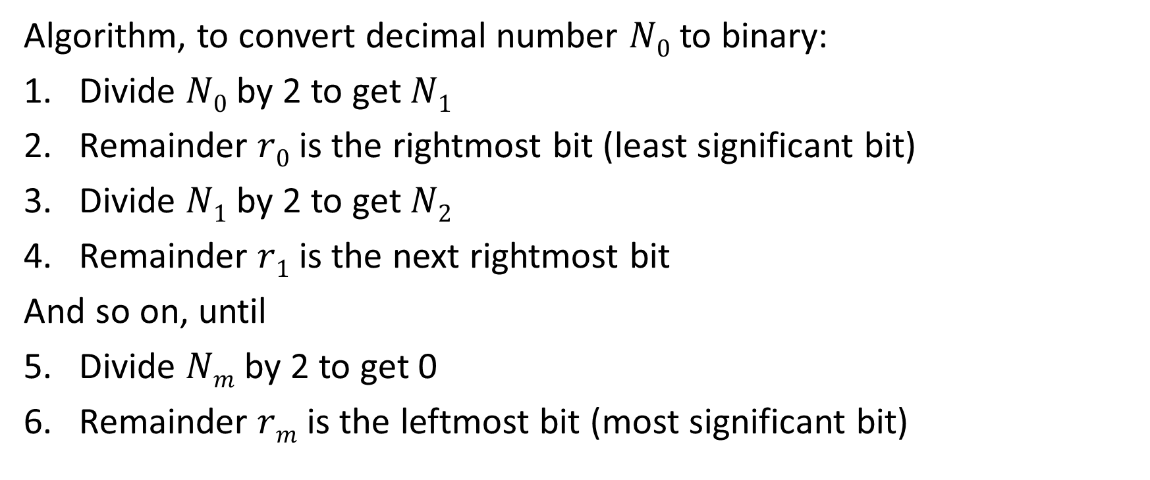
Converting decimal to binary
Algorithm, to convert decimal number $N0$ to binary:
Divide $N0$ by 2 to get $N1$
Remainder $r0$ is the rightmost bit (least significant bit)
Divide $N1$ by 2 to get $N2$
Remainder $r1$ is the next rightmost bit
And so on, until
Divide $Nm$ by 2 to get 0
Remainder $rm$ is the leftmost bit (most significant bit)

Slide 21
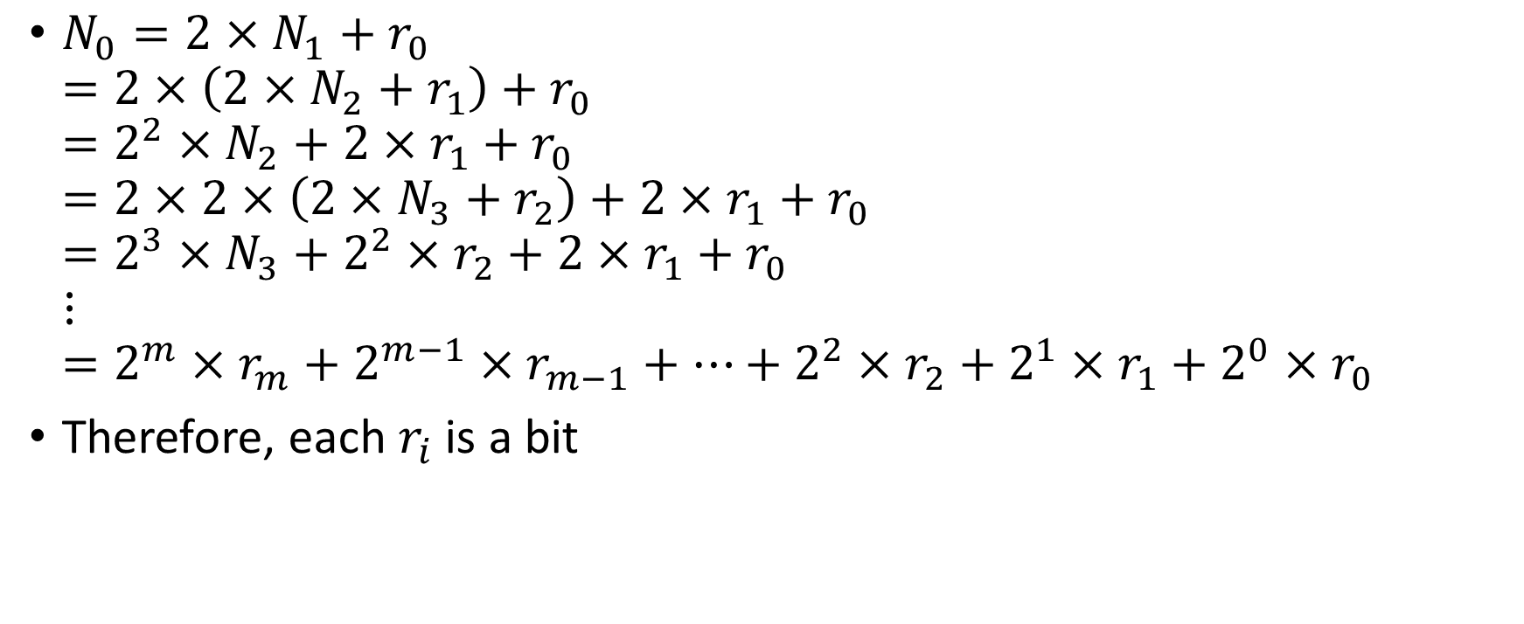
Why does this work?
$N_{0}=2×N_{1}+r_{0}$
$=2×\left(2×N_{2}+r_{1}\right)+r_{0}$
$=2^{2}×N_{2}+2×r_{1}+r_{0}$
$=2×2×\left(2×N_{3}+r_{2}\right)+2×r_{1}+r_{0}$
$=2^{3}×N_{3}+2^{2}×r_{2}+2×r_{1}+r_{0}$
$⋮$
$=2^{m}×r_{m}+2^{m−1}×r_{m−1}+…+2^{2}×r_{2}+2^{1}×r_{1}+2^{0}×r_{0}$
Therefore, each $r_{i}$ is a bit

Slide 22
Example: converting decimal to binary
42₁₀
42 / 2 = 21, remainder 0. Rightmost bit is 0.
21 / 2 = 10, remainder 1. Next rightmost bit is 1.
10 / 2 = 5, remainder 0. Next bit is 0.
5 / 2 = 2. remainder 1. Next bit is 1.
2 / 2 = 1, remainder 0. Next bit is 0.
1 / 2 = 0, remainder 1. Last bit is 1.
Put these in reverse order (because we go right to left) to get 101010₂

Slide 23
Example: alternative solution
Power | 6 | 5 | 4 | 3 | 2 | 1 | 0
Base 2 | 64 | 32 | 16 | 8 | 4 | 2 | 1
 |  | 1 | 0 | 1 | 0 | 1 | 0
Integer |  | 42 / 32 | 10 / 16 | 10 / 8 | 2 / 4 | 2 / 2 | 0 / 1
 |  | = 1 | = 0 | = 1 | = 0 | = 1 | = 0
Remainder |  | 10 | 10 | 2 | 2 | 0 | 0

Slide 24
Exercise: converting decimal to binary
Now You: Convert 115₁₀ to binary

Slide 25
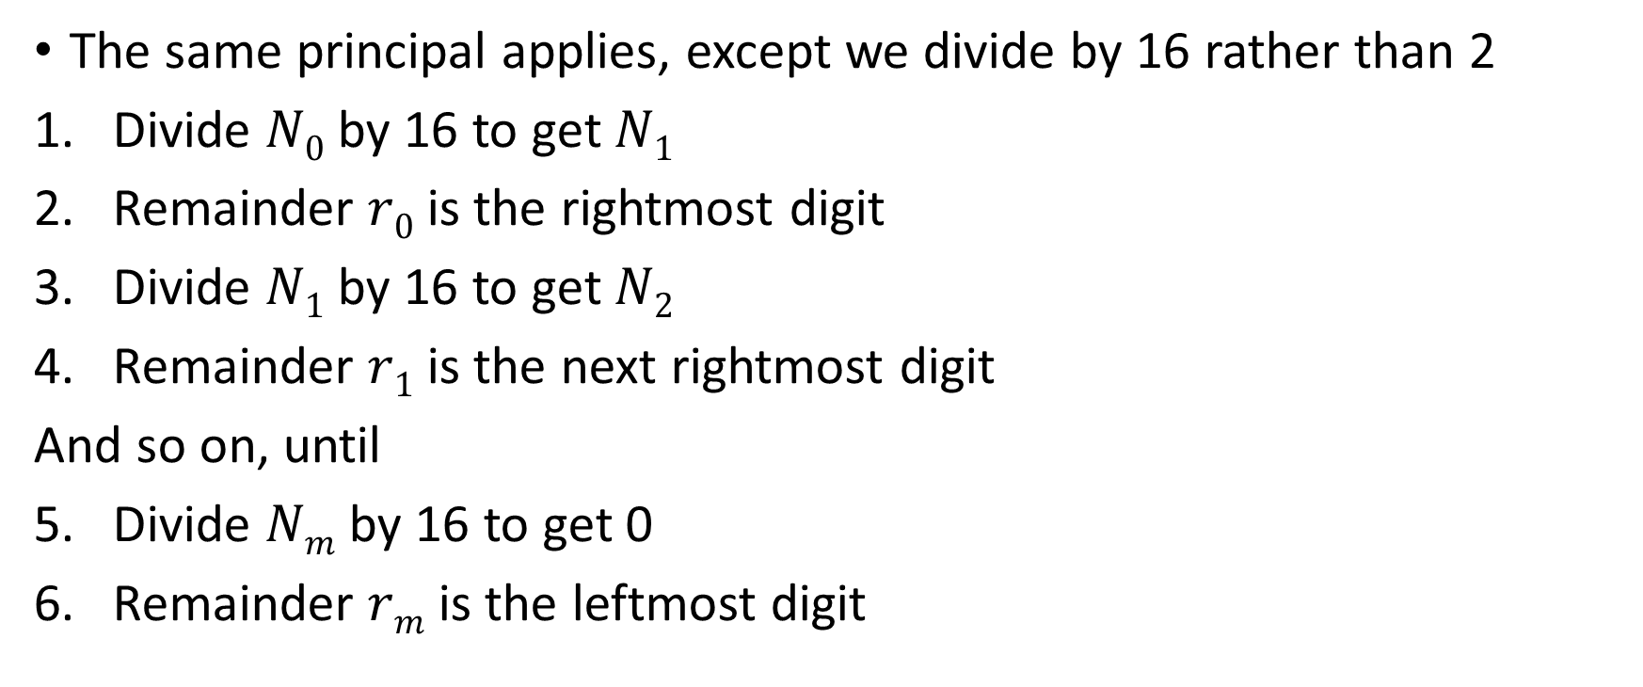
Converting decimal to hexadecimal
The same principal applies, except we divide by 16 rather than 2
Divide $N0$ by 16 to get $N1$
Remainder $r0$ is the rightmost digit
Divide $N1$ by 16 to get $N2$
Remainder $r1$ is the next rightmost digit
And so on, until
Divide $Nm$ by 16 to get 0
Remainder $rm$ is the leftmost digit

Slide 26
Example: converting decimal to hexadecimal
Show 8039₁₀ = 1F67₁₆
Divide 8039 by 16 to get 502, remainder 7. Rightmost digit is 7.
Divide 502 by 16 to get 31, remainder 6. Next digit is 6.
Divide 31 by 16 to get 1, remainder 15. Next digit is F (15).
Divide 1 by 16 to get 0, remainder 1. Last digit is 1.
Reverse order to get 1F67.

Slide 27
Exercise: converting decimal to hexadecimal
Now you: Convert 65261₁₀ to hexadecimal

Slide 28
Converting hexadecimal to binary
Converting between binary and hexadecimal is much easier
Remember that 4 bits give 16 possible values (2⁴): 0 to 15.
  Hexadecimal has 16 digits representing 0 to 15
Hex to binary: Convert each hex digit to 4-bit binary and concatenate (from left to right)
Binary to hex: Split binary into groups of 4 bits (from right) and convert each group of 4 bits to a hex digit

Slide 29
Example
1F67₁₆ to binary
1 is 0001 as 4 binary digits
F(15) is 1111
6 is 0110
7 is 0111
Concatenated, from left to right, gives 0001 1111 0110 0111
Removing leading zeroes gives 1 1111 0110 0111₂.

Slide 30
Example: converting hexadecimal to binary
Convert 1100000000111010₂ to hexadecimal
Split into groups of four bits: 1100 0000 0011 1010
Convert each group:
  1100 is C (12)
  0000 is 0
  0011 is 3
  1010 is A (10)
Hence, C03A₁₆

Slide 31
Exercise: converting hexadecimal to binary
Now You: Convert 789₁₆ to binary

Slide 32
Binary Fractions: Radix Point
Decimal point in base 10
Binary point in base 2
Some numbers cannot be represented (exactly) in some bases (with terminating, finite representations). Exact conversion may be impossible.

Slide 33
Decimal Fractions
Move the number point one place to the right:
  Effect multiplies the number by the base number
  Example 139.0₁₀ → 1390₁₀
Move the number point one place to the left:
  Effect divides the number by the base number
  Example 139.0₁₀ → 13.9₁₀

Slide 34
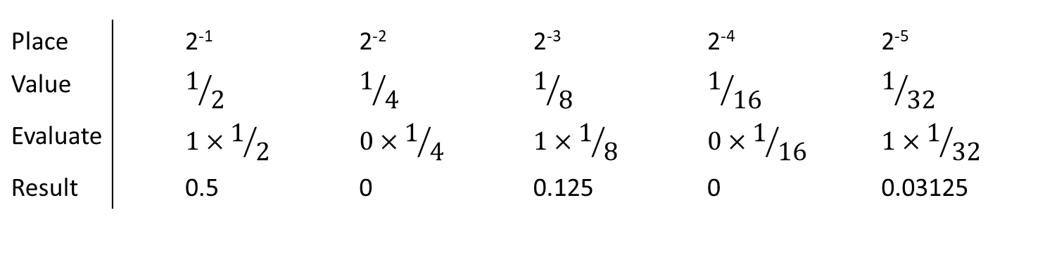
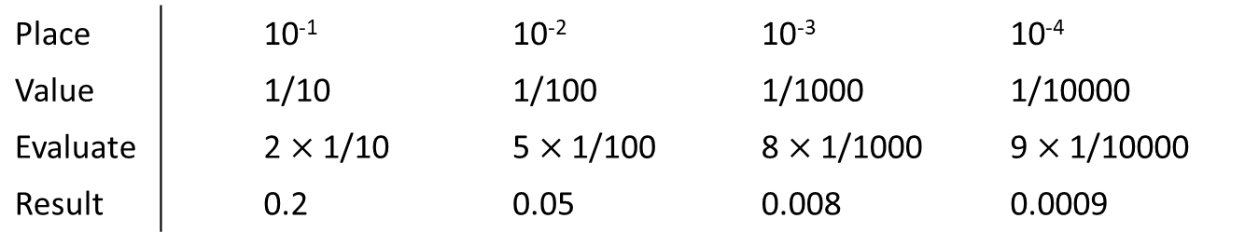
Binary Fractions
0.2589₁₀
Place |  | 10⁻¹ | 10⁻² | 10⁻³ | 10⁻⁴
Value |  | 1/10 | 1/100 | 1/1000 | 1/10000
Evaluate |  | 2 $×$ 1/10 | 5 $×$ 1/100 | 8 $×$ 1/1000 | 9 $×$ 1/10000
Result |  | 0.2 | 0.05 | 0.008 | 0.0009
0.10101₂ = 0.65625₁₀
Place |  | 2⁻¹ | 2⁻² | 2⁻³ | 2⁻⁴ | 2⁻⁵
Value |  | $$1/2$$ | $$1/4$$ | $$1/8$$ | $$1/{16}$$ | $$1/{32}$$
Evaluate |  | $$1×1/2$$ | $$0×1/4$$ | $$1×1/8$$ | $$0×1/{16}$$ | $$1×1/{32}$$
Result |  | 0.5 | 0 | 0.125 | 0 | 0.03125

Slide 35
Binary and Decimal Fractions
There is no general relationship between fractions of types 1/10^{k} and 1/2^{k}.
Therefore, a number representable in base 10 may not be representable in base 2.
But the converse is true: all fractions of the form 1/2^{k} can be represented in base 10.

Slide 36
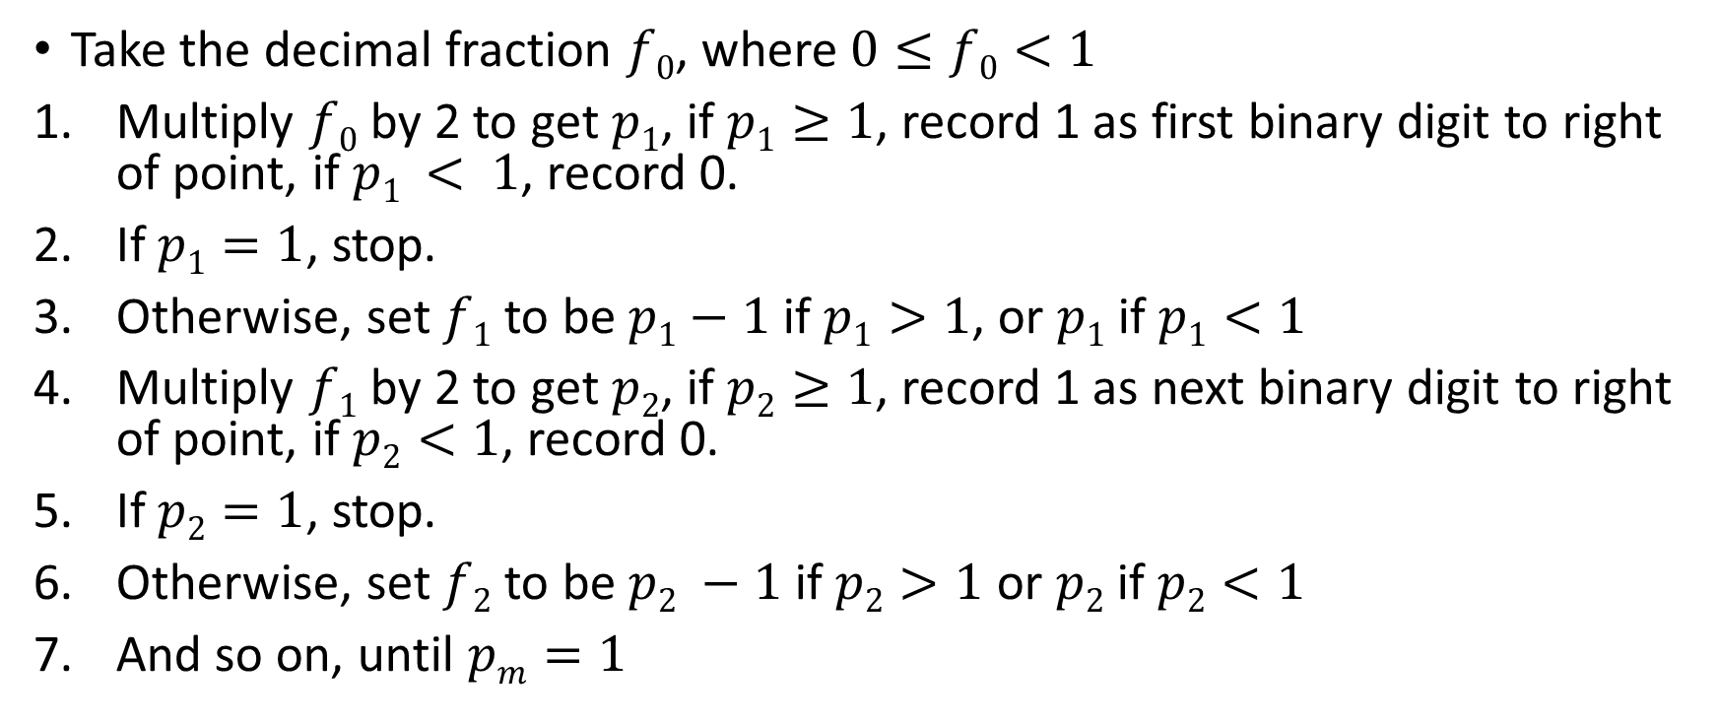
Converting decimal fractions to binary
Take the decimal fraction $f0$, where $0≤f0<1$
Multiply $f0$ by 2 to get $p1$, if $p1≥1$, record 1 as first binary digit to right of point, if $p1 < 1$, record 0.
If $p1=1$, stop.
Otherwise, set $f1$ to be $p1−1$ if $p1>1$, or $p1$ if $p1<1$
Multiply $f1$ by 2 to get $p2$, if $p2≥1$, record 1 as next binary digit to right of point, if $p2<1$, record 0.
If $p2=1$, stop.
Otherwise, set $f2$ to be $p2 −1$ if $p2>1$ or $p2$ if $p2<1$
And so on, until $pm=1$

Slide 37
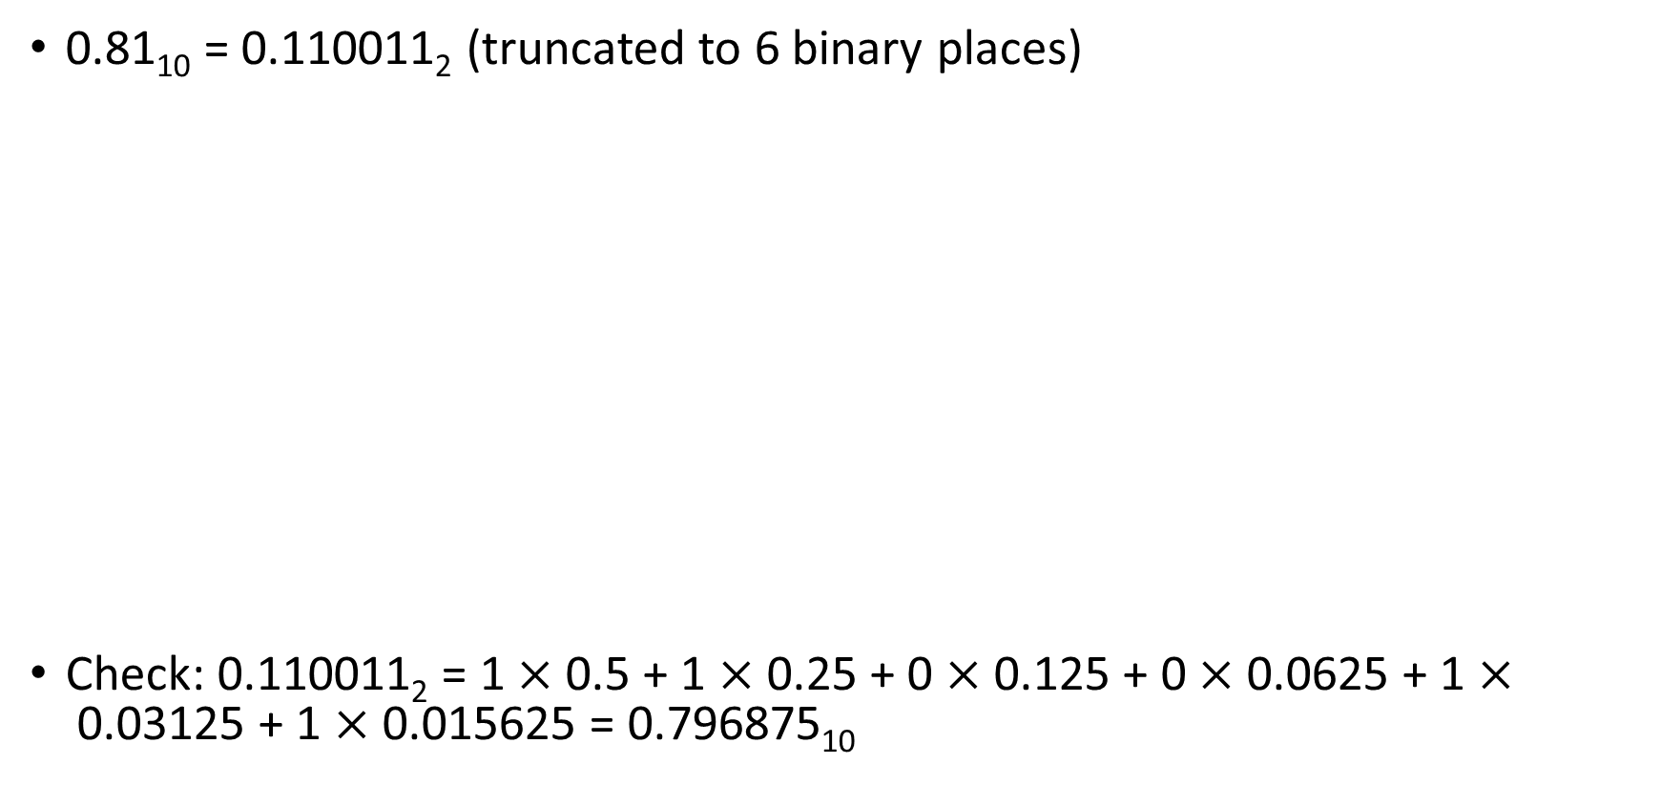
Example
0.81₁₀ = 0.110011₂ (truncated to 6 binary places)
Check: 0.110011₂ = 1 $×$ 0.5 + 1 $×$0.25 + 0 $×$0.125 + 0 $×$0.0625 + 1 $×$0.03125 + 1 $×$0.015625 = 0.796875₁₀
Step | Fraction | Product | Bit
1 | 0.81 | 1.62 | 1
2 | 0.62 | 1.24 | 1
3 | 0.24 | 0.48 | 0
4 | 0.48 | 0.96 | 0
5 | 0.96 | 1.92 | 1
6 | 0.92 | 1.84 | 1

Slide 38
Example
0.25₁₀ = 0.01₂ (exactly)
Step | Fraction | Product | Bit
1 | 0.25 | 0.5 | 0
2 | 0.5 | 1.0 | 1

Slide 39

Mixed number conversion
Integer and fractional parts must be converted separately
Radix point: fixed reference for the conversion
Digit to the left is a unit digit in every base
$B0$ is always 1 regardless of the base $B$.

Slide 40
Exercise
Convert (8.375)₁₀ to binary.
Convert (1.101)₂ to decimal.

Slide 41
Integer Representations

Slide 42
Integer Representation
In the binary number system arbitrary numbers can be represented with:
  The digits zero and one
  The minus sign (for negative numbers)
  The period, or radix point (for numbers with a fractional component)
  For purposes of computer storage and processing we do not have the benefit of special symbols for the minus sign and radix point
  Only binary digits (0,1) may be used to represent numbers

Slide 43

Unsigned Integer
An unsigned integer represent values from 0 to $2^{n}−1$
$n$ number of bits for representation
Bits | Min value | Max
1 | 0 | 1
4 | 0 | 15
8 | 0 | 255
10 | 0 | 1023
16 | 0 | 65535
20 | 0 | 1 048 575
32 | 0 | 4 294 967 295

Slide 44
Binary Coded Decimal
Complicated to do binary conversion to display numbers
Unsigned integer
Integers are stored as decimal numbers
  Sequence of binary encodings of decimal digits
Each decimal digit is stored as its 4-bit binary equivalent
E.g., 478₁₀
  Convert 4, 7, & 8 to binary – 100, 111, 1000 respectively
  Prepend values less then 4 bits with zeroes, i.e. 0100, 0111, 1000
  Concatenate these values, i.e. 478 is represented as 0100 0111 1000

Slide 45
Exercise
Convert 251₁₀ to BCD

Slide 46
Binary vs BCD
Decimal | Binary | BCD
68 | 0100 0100 | 0110 1000
99 | 0110 0011 | 1001 1001 | Largest 8-bit BCD
255 | 1111 1111 | 0010 0101 0101 | Largest 8-bit binary

Slide 47
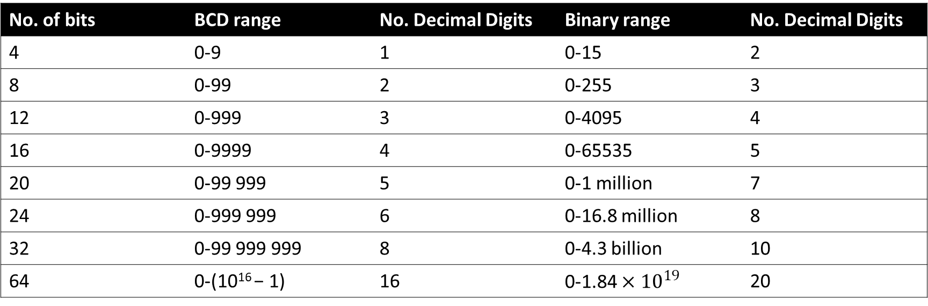
Value range: binary vs BCD
Binary: 4 bits can hold 16 values (0 to 15)
BCD: 4 bits used to hold only 10 different values (0 to 9)
No. of bits | BCD range | No. Decimal Digits | Binary range | No. Decimal Digits
4 | 0-9 | 1 | 0-15 | 2
8 | 0-99 | 2 | 0-255 | 3
12 | 0-999 | 3 | 0-4095 | 4
16 | 0-9999 | 4 | 0-65535 | 5
20 | 0-99 999 | 5 | 0-1 million | 7
24 | 0-999 999 | 6 | 0-16.8 million | 8
32 | 0-99 999 999 | 8 | 0-4.3 billion | 10
64 | 0-(10¹⁶ − 1) | 16 | 0-1.84 $×{10}^{19}$ | 20

Slide 48
Binary vs BCD
A binary representation is general preferred.
BCD for integers only used by certain business applications where input and output are more common than calculations

Slide 49
Signed integer representation
Sign-magnitude representation
2’s complement

Slide 50
Sign-magnitude
Left most bit is the sign bit
0 means positive
1 means negative
+18 = 00010010
−18 = 10010010
Problems:
  We need to consider both sign and magnitude in arithmetic
  Two representations of zero (+0 and −0)
Because of these drawbacks, sign-magnitude representation is rarely used in implementing the integer portion of the ALU

Slide 51
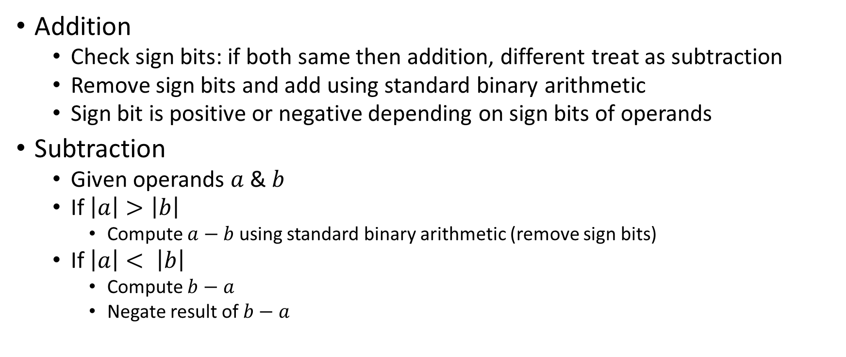
Sign magnitude arithmetic
Addition
  Check sign bits: if both same then addition, different treat as subtraction
  Remove sign bits and add using standard binary arithmetic
  Sign bit is positive or negative depending on sign bits of operands
Subtraction
  Given operands $a$ & $b$
  If $\left|a\right|>\left|b\right|$
    Compute $a−b$ using standard binary arithmetic (remove sign bits)
  If $\left|a\right|< \left|b\right|$
    Compute $b−a$
    Negate result of $b−a$

Slide 52
Sign magnitude arithmetic
Multiplication
  Check if the two numbers have the same sign
  Remove the signs and multiply the numbers
  If the numbers had different signs originally, negate the answer.
Division
  Check if the two numbers have the same sign
  Remove the signs and divide the numbers
  If the numbers had different signs originally, negate the answer.

Slide 53
Summary
Binary & Hexadecimal number systems
  Conversion
  Arithmetic
Representations of integers
  Unsigned integer
  BCD
  Sign-magnitude

